Slide 1
Predictive Analysis on Hotel Cancellations
∞
TEAM 8

Slide 2
Deployment
Evaluation
Modeling
Data
Preparation
Data
Understanding
Business Understanding

Slide 3
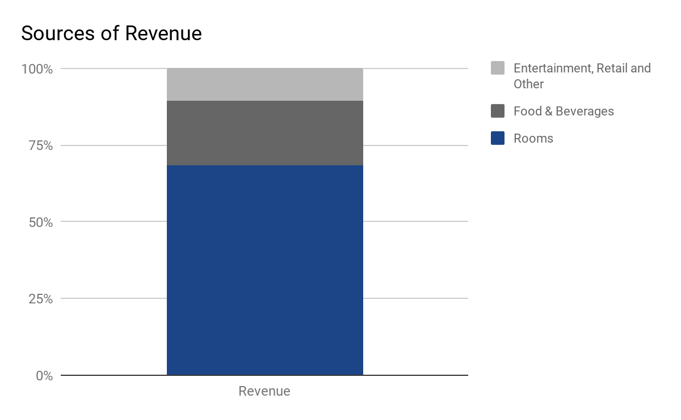
Business Understanding
Industry: Hospitality - Hotel
Performance Metric: RevPAR
Revenue per available room
Booking cancellations directly affects RevPAR
Source: Statista

Slide 4
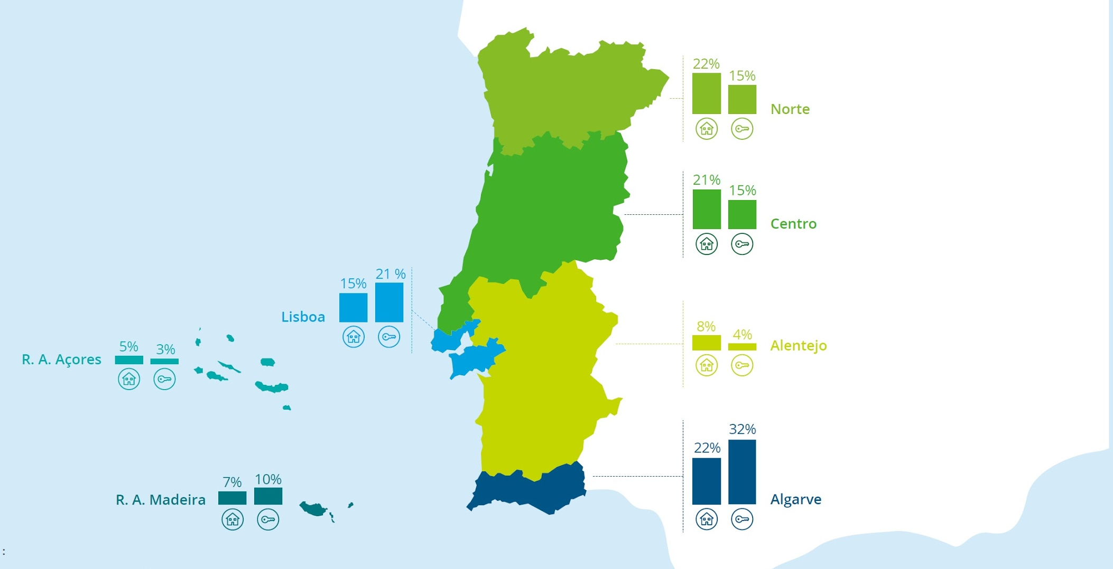
Business Understanding
Location: Portugal
Lisbon (City Hotels)
Argarve (Resort Hotels)
Source: Deloitte Industry Report 2017

Slide 5
Problem Translation
Business Problem
How can we decrease the room booking vacancy rate and increase profit?
Data Science Problem
At the time of booking, predict the likelihood of the reservation being cancelled at any time until the corresponding check-in date.

Slide 6
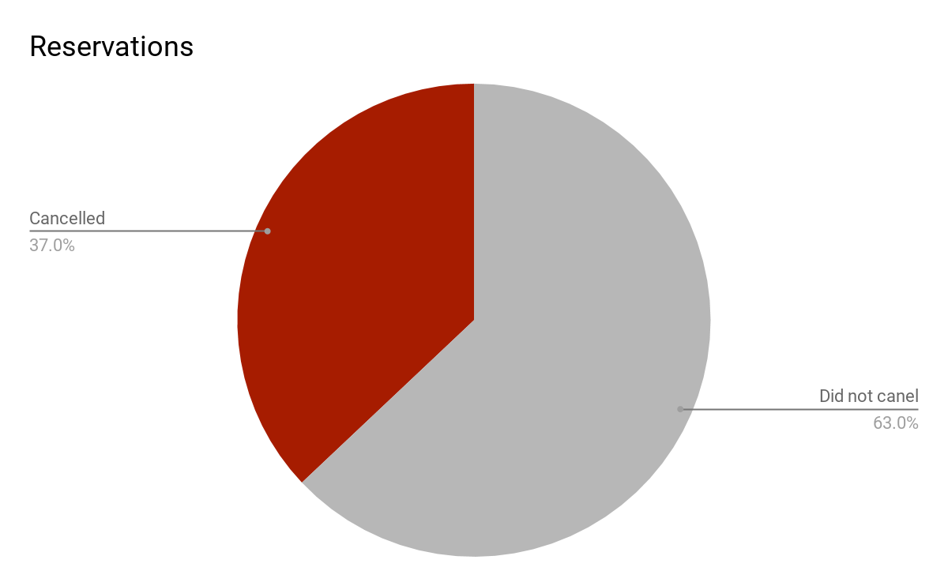
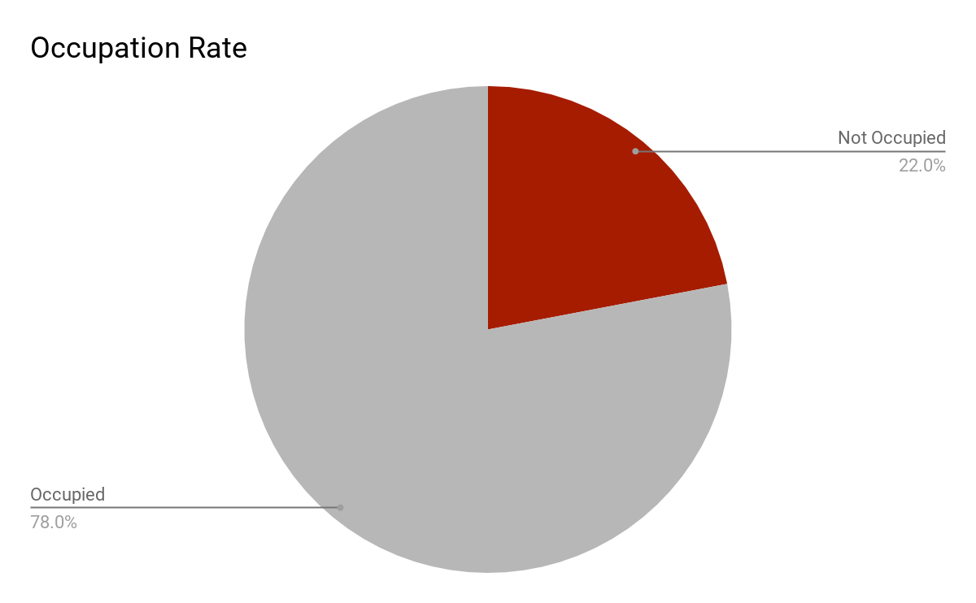
Data Overview
119390 reservations, 32 features
Target Variable: reservation cancellation
Hotels: Resort and City
Types of Variables: Numerical and Categorical
Source: Statista

Slide 7
EXPLORATORY DATA ANALYSIS
1

Slide 8
Data Understanding
When/How long?
For Whom?
Booking information
What do they need?
Adults
Hotel
Lead time
Reserved room type
Children
Average daily rate
Arrival date year
Meal
Babies
Booking changes
Arrival date month
Total of special requests
Is repeated guest
Deposit type
Stays in weekend nights
Required parking spaces
Country
Days in waiting list
Stays in week nights
Customer type
Agent
Previous cancels
Distribution channel

Slide 9
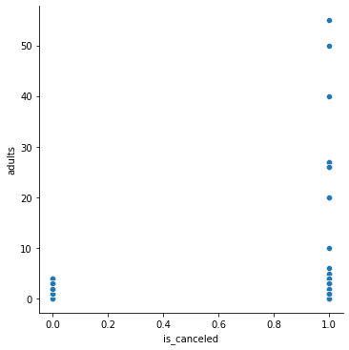
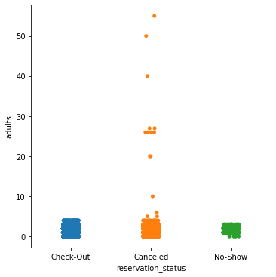
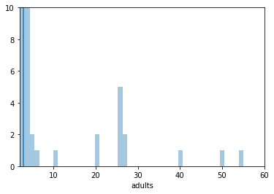
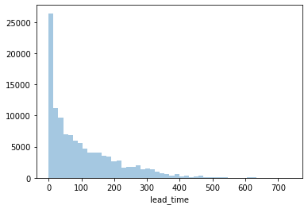
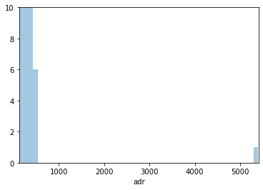
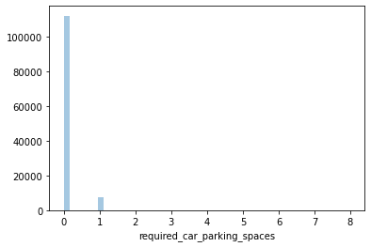
Exploration
Does not include all features

Slide 10
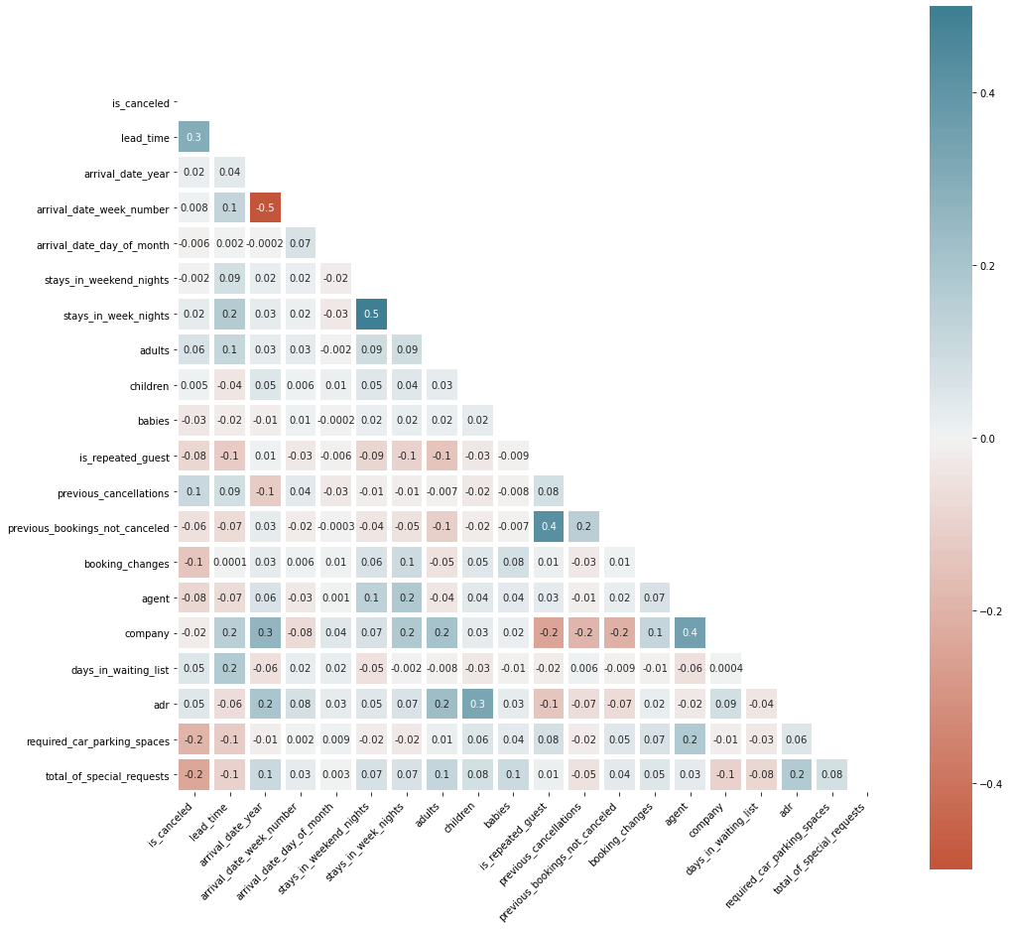
Correlation Matrix
No high correlation
between the predictors and target variable
Among most of the predictor variables
Price (time-series/Autocorrelation)
Average Daily Rate Mean:
2015: 87.17
2016: 98
2017: 114
Price is increasing each year
so we transformed variable to remove inflation

Slide 11
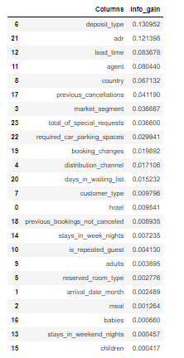
Information Gain
Information gain for each predictor is low (at .10s)
Still, we get rank order on which predictors are more informative
Top 3:
Deposit type
Average daily rate
Lead time

Slide 12
DATA PREPARATION
2

Slide 13
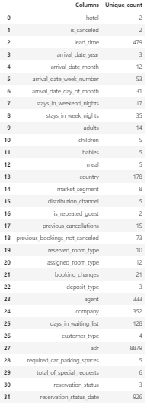
Dropped Features
Leakage
Assigned room type: assigned once customer checks in
Reservation status: changes to either cancelled or check-out
Reservation status date: used in conjunction with reservation status
Redundancy
Information gained can be acquired from another attribute
Arrival date week number
Arrival date day of month
Arrival date year
Outliers/High leverage points
E.g. $5000 room, company trip
Features with too many levels
E.g. Countries

Slide 14
Country Transformation
Country attribute tells the customer’s country of origin
There were 178 different categories
To address the large dimensions we imported a country codes index which corresponds sub-regions to each country code
For countries that had less than 500 we remapped their value to corresponding sub-region
For sub-regions less than 500 occurrences we further group them into regions or “others”
We were able to get the country categories down to 28 dimensions

Slide 15
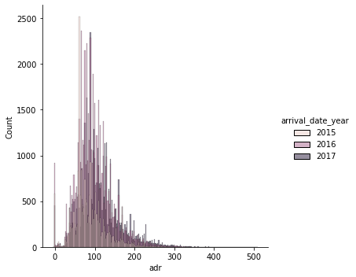
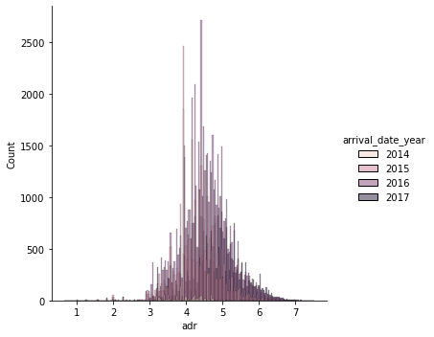
Average Daily Rate Transformation
1
2
3
4
Calculate booking date based on arrival date and lead time (day).
Calculate price changes% based on average price of the previous month
Combine columns(arrival year & month) to get exact arrival date
Calculate corresponding average price for each month

Slide 16
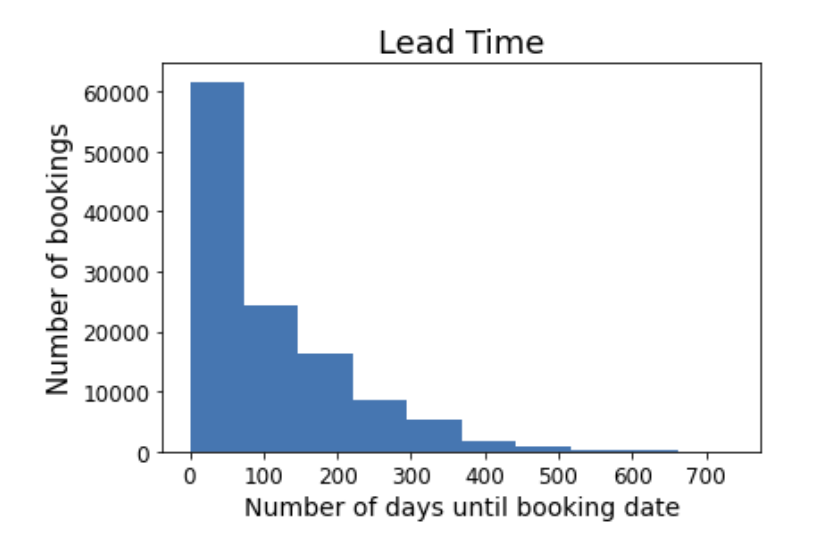
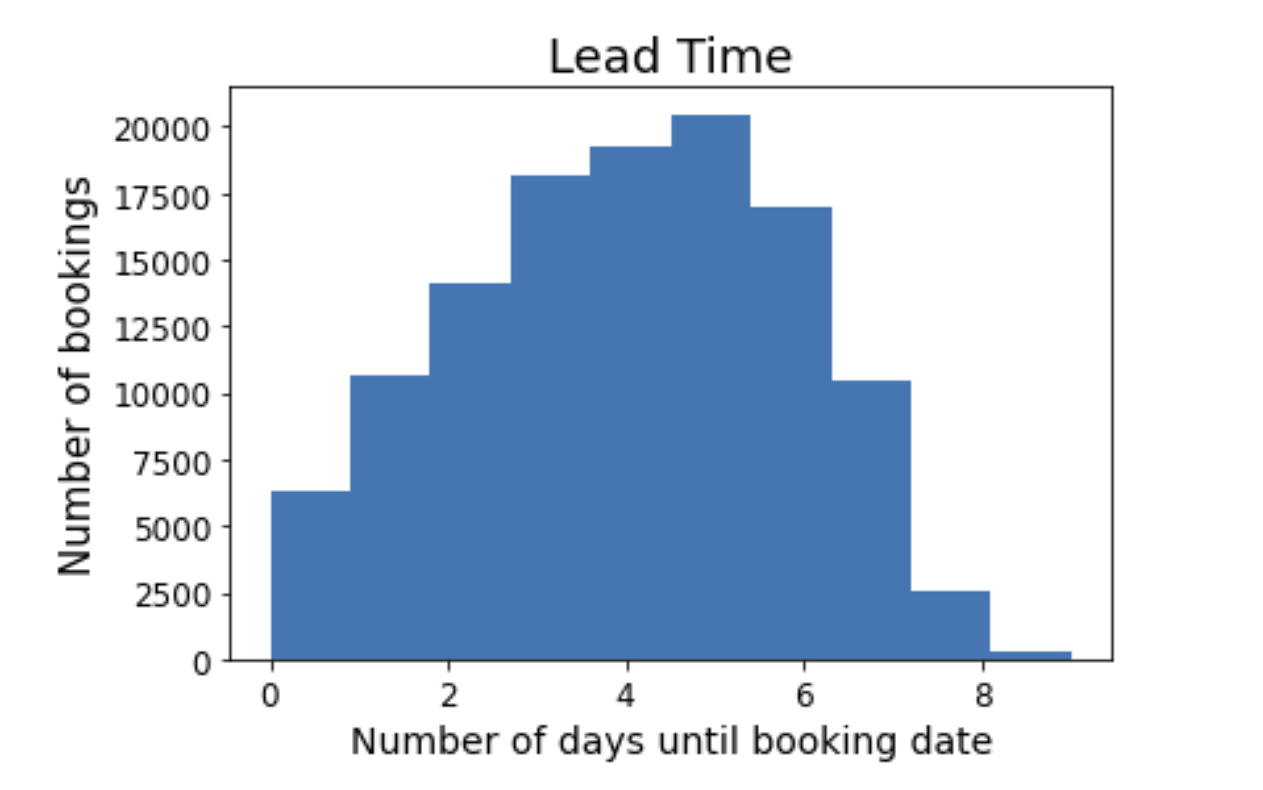
Normalizing distributions
Lead Time
Stays in Weekend Nights

Slide 17
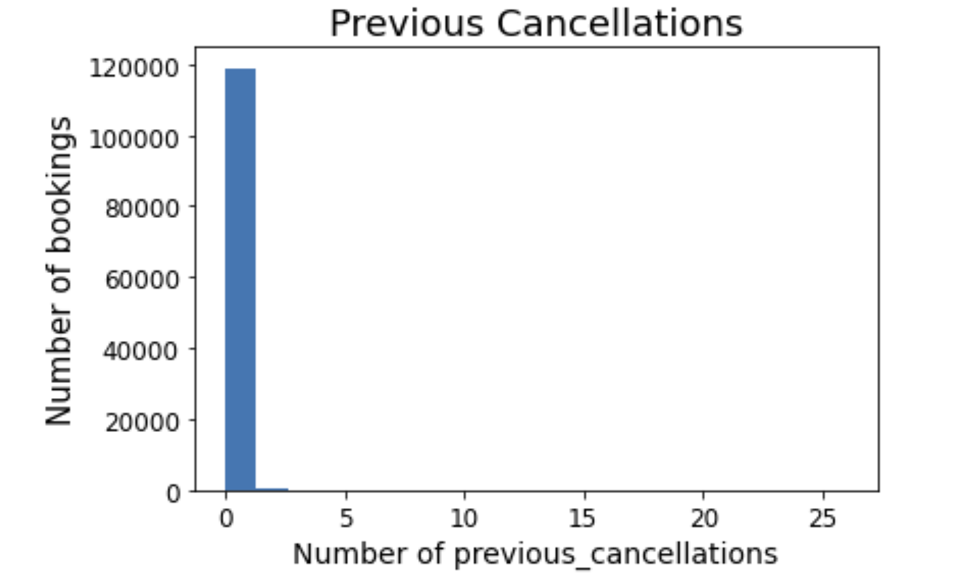
Regrouped Variables
Agents
Children
Babies
Adults
Previous Cancellations
Previous Bookings Not Canceled
Days on Waiting List
Booking Changes
Required Car Parking Spaces
Reserved Room Type

Slide 18
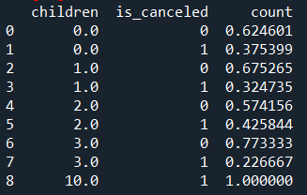
Quadratic Features for Linear Models
Children
Number of Week Nights

Slide 19
Data Preparation
24 Features
&
Eliminate 500+ Meaningless Dimensions
When/How long?
For Whom?
Booking information
What do they need?
Adults
Hotel
Lead time
Reserved room type
Children
Average daily rate
Arrival date year
Meal
Babies
Booking changes
Arrival date month
Total of special requests
Is repeated guest
Deposit type
Stays in weekend nights
Required parking spaces
Country
Days in waiting list
Stays in week nights
Customer type
Agent
Previous cancels
Distribution channel

Slide 20
Modeling
3

Slide 21
Applied Techniques
Supervised Classification
One Hot Encoder
Nested Cross Validation
Standardization
Grid Search

Slide 22

Generalization Performance
Support Vector Machine
Optimal Parameter: C: 0.01, class_weight: balanced, penalty: l2
F1: 77%
kNN
With Standardization
Optimal parameters: 21 neighbors, p:1, weights: distance, f1:86%
Decision Tree
Logistic Regression
Optimal Parameters:
Criterion: Entropy, Max depth = 15
Min samples leaf = 7, F1: 84%
Used the quadratic of the children and weeknights predictors
Optimal parameters: C = 10, penalty = l2, F1: 77%
86%
Random Forest
84%
Optimal parameters:
Criterion: ‘gini’, Max depth = 25 , Number of trees = 500, F1: 88%
86%
77%
F1
Performance
88%

Slide 23
Why these models?
01
Supervised Learning vs Unsupervised Learning
Supervised Learning is appropriate in this context because we have historical data and have a specific target variable for which we want to enhance prediction.
02
Classification vs Numeric Prediction
This is a classification task because the target variable is binary - whether the booking was canceled or not. Therefore, we can choose models that are suitable for classification prediction.
03
Pros and Cons of Linear Models
Linear models such as logistic regression and support vector machine can capture nonlinear relationships by incorporating polynomial features. We engineered two quadratic features in our model. A drawback is that with large dataset, these models are not able to capture complexities in the data as much as tree models.
04
Pros and Cons of Tree Models
Tree models give flexible representation and are great at capturing high complexities when the dataset is large. Needing a good data size can be a drawback, but we have enough data points in this case.

Slide 24
Model Evaluation
4

Slide 25
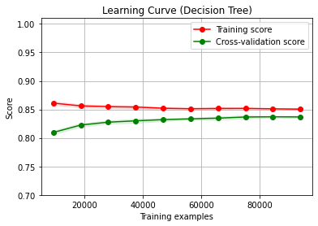
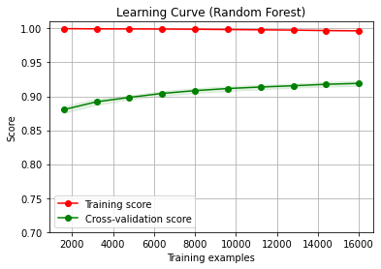
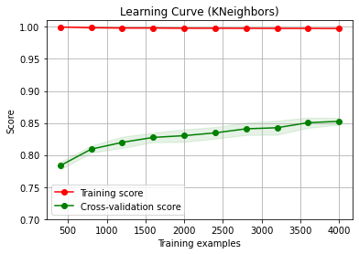
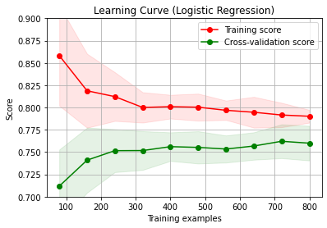
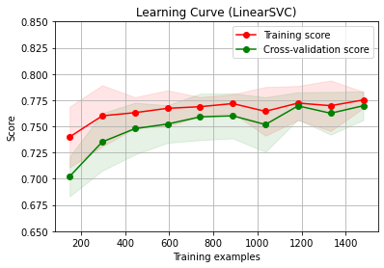
Learning Curves

Slide 26
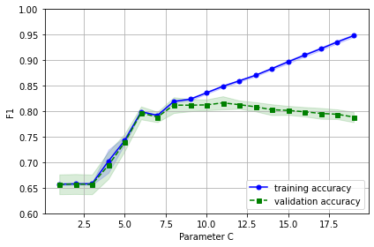
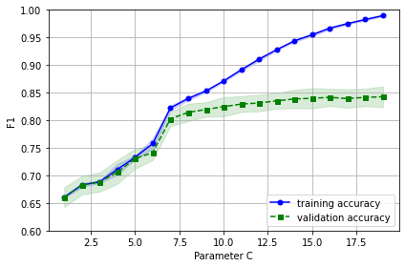
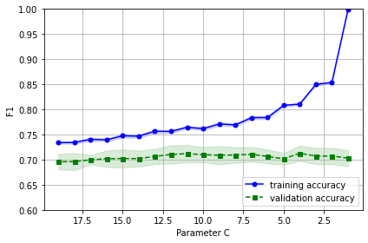
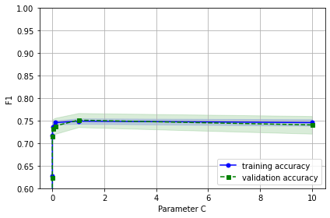
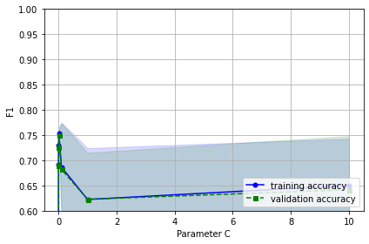
Fitting Curve
Decision Tree
Random Forest
K Neighbors
Logistic Regression
Support Vector Machine

Slide 27
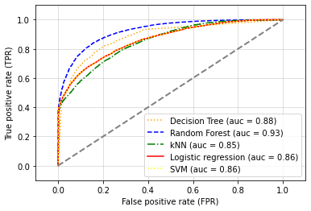
ROC CURVE

Slide 28
TRUE POSITIVE:
Correctly predicted cancellations
Benefit: price of filling the room
FALSE POSITIVE:
Correctly predicted non-cancellations
Cost: refund room price, pay price difference for customer to find another room
Classification Costs and Benefits
Assumptions:
If able to identify cancellation, hotel will fill vacancy
Hotel is fully booked
FALSE NEGATIVE:
Predicted customer will cancel but did not
No cost/benefit
TRUE NEGATIVE:
Predicted customer will not cancel but canceled
No cost/benefit

Slide 29
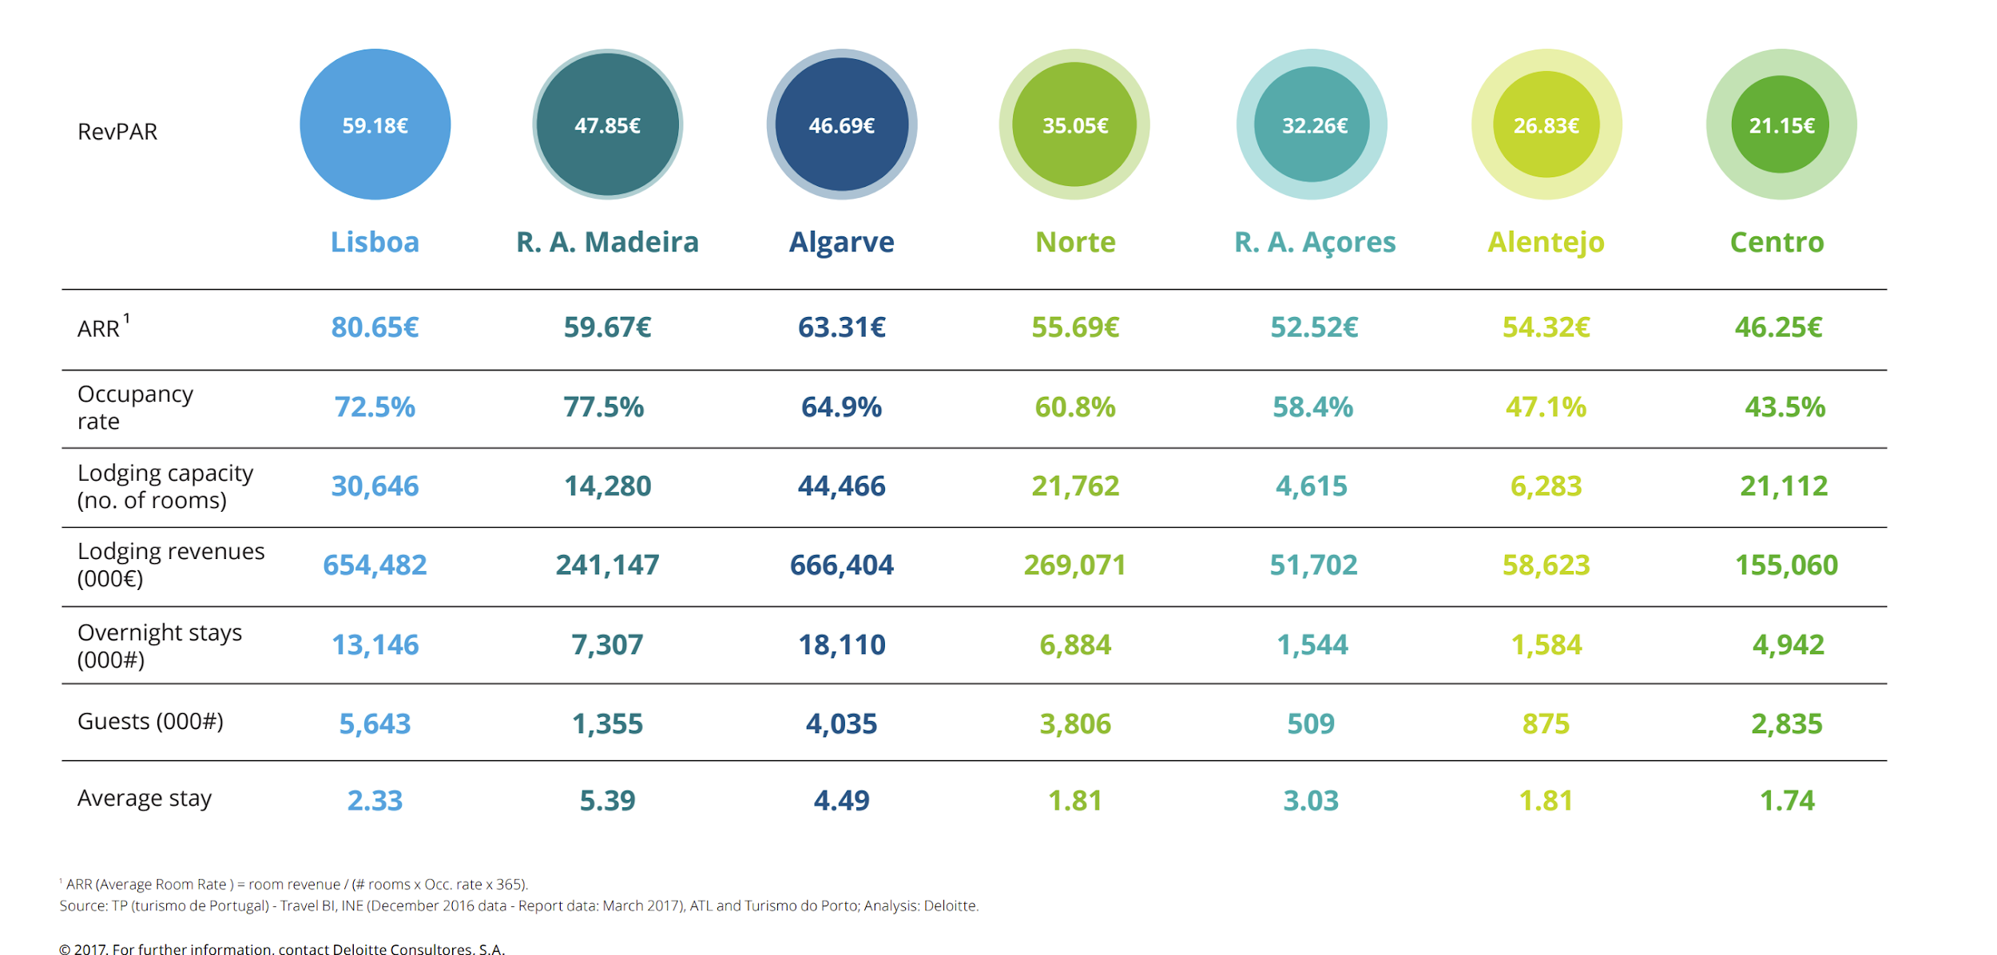
Back to our business problem..
Source: Deloitte Industry Report 2017
Notes:
Discuss how the result of the data mining is/should be evaluated - should be analyzed based on true positives (benefits) and false positives(costly). How should a business case be developed to project expected improvement? ROI? By deploying our model the business should expect a decrease in vacancy rates.

Slide 30
Deployment
5

Slide 31
Deployment Considerations
How
Be careful
Ethics
Risks
Incorporation in the online booking platform
Real-time prediction
Allow overbook
False positives are costly:
cost of double booking,
bad customer experience
Race, Gender, Age Nationalities
Costly overbooks: presidential suites, penthouses
Mitigation: alert system for overbook of certain type of rooms
Notes:
The prediction model will be incorporated in the online booking platform and produce real time prediction at the time a new reservation is made. When it predicts a cancellationll allow another user to double book. False positives are costly:cost of double booking, bad customer experience.Ethics: Need to check if classifier is canceling a disproportionate number of people when they are grouped into different gender,

Slide 32

Thank you

Slide 33
Sources
Country Code Dataset
https://github.com/lukes/ISO-3166-Countries-with-Regional-Codes/blob/master/all/all.csv
Data Source: Kaggle - ‘Hotel Booking Demand Dataset’ by Nuno Antonio
https://www.sciencedirect.com/science/article/pii/S2352340918315191

